Slide 1


EfficientNet-Based and YOLO-Driven Brain Tumor Detection and Segmentation
Presentation on,
26-04-2025
Authors:
Najla Musthafa¹, Mohammed Aflah², Minhaj Akavalappil², Mohammed Jasim A²,
Mohammed Aseel², Shanid Malayil³, Mubeena A K¹.
¹Assistant Professor, Dept. of CSE, MEA Engineering College, Kerala, India
²Dept. of CSE, MEA Engineering College, Kerala, India
³Associate Professor, Dept. of CSE, MEA Engineering College, Kerala, India
ICCSCE 2025

Slide 2

Outline
Introduction
Background Information
Proposed System
Methodology
Results
Discussion
Conclusion
References

Slide 3
Introduction
Brain tumors are life-threatening and require early, accurate diagnosis to improve survival rates.
Manual MRI diagnosis is time-consuming, subjective, and prone to human error.
AI and Deep Learning offer automation, speed, and increased diagnostic accuracy.
EfficientNet-B0 is used to classify tumors into four categories (glioma, meningioma, pituitary, no tumor).
YOLOv8 performs real-time segmentation to localize the tumor in MRI scans.
This integrated system supports radiologists with fast and reliable second opinions.

Slide 4
Background Information
MRI is the standard imaging tool for brain tumors due to its detailed visualization of soft tissues.
Traditional ML methods (like SVMs, kNN) rely on handcrafted features and struggle with complex medical data.
CNNs automatically extract deep features and improve image classification and segmentation performance.
Transfer Learning enables pre-trained models to work effectively on small medical datasets.
EfficientNet balances model size and accuracy through compound scaling.
YOLOv8 ensures fast, accurate segmentation—ideal for clinical use and real-time diagnosis.

Slide 5
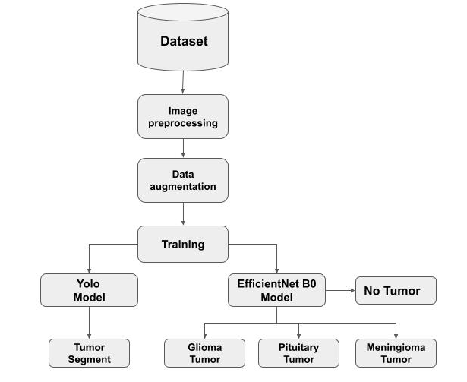
Proposed System

Slide 6
Methodology
1. Dataset Collection: Collect 5000 MRI images across 4 categories — glioma tumor, meningioma tumor, pituitary tumor, and no tumor.
2. Data Preprocessing:
Augmentation: Apply rotation, flipping, zooming for data diversity.
Annotation: Tumor regions manually marked for segmentation.
3. Model Selection:
Use EfficientNet-B0 (pretrained on ImageNet) for classification.
Use YOLOv8 for segmentation (to detect and outline tumor regions).
4. Training:
EfficientNet-B0: Fine-tuned using Transfer Learning for 4-class classification.
YOLOv8: Trained to detect and segment tumors using annotated images.

Slide 7
Methodology
5. Loss Functions:
Classification Loss: Categorical Cross-Entropy:
L = -∑(y_true * log(y_pred))
Segmentation Loss: Intersection over Union (IoU):
IoU = |A ∩ B| / |A ∪ B|
6. Evaluation:
Classification Metrics: Accuracy, Sensitivity, Specificity, F1-score.
Segmentation Metric: IoU (measures overlap between predicted and actual tumor area).
7. Deployment:
Plan to develop a simple application for radiologists to upload MRI scans and get instant tumor detection and classification results.

Slide 8
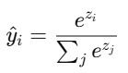

Methodology - Classification
Images resized to 150×150 for EfficientNet input.
Transfer learning applied using weights from ImageNet.
Final layer: Softmax for 4-class probability distribution.
Each class probability = (exponentiated value) / (sum of all exponentiated values).
zᵢ = raw score for class i.
Example: If scores for 4 classes are: [2, 1.5, 0.5, -0.5]
This gives probabilities like [0.7, 0.2, 0.08, 0.02].
Loss Function: Categorical Cross-Entropy
L = -∑(y_true * log(y_pred))

Slide 9
Methodology - Segmentation
Images resized to 416×416 for YOLOv8.
Annotated tumor regions (bounding boxes and masks) fed into model.
Segmentation performance measured using: IoU (Intersection over Union):
IoU = |A ∩ B| / |A ∪ B|
A: The predicted tumor region.
B: The actual tumor region (from the dataset).
YOLOv8 provides real-time segmentation outputs.

Slide 10
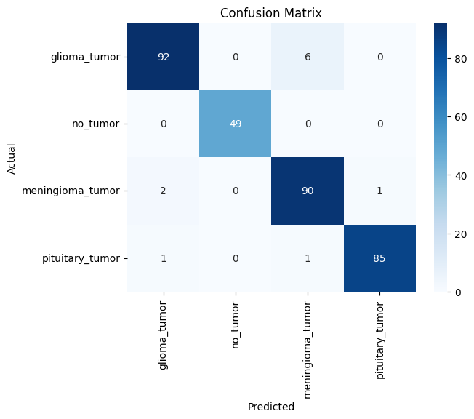
Confusion Matrix

Slide 11
Result
Accurate Tumor Classification
EfficientNet-B0 achieves final training accuracy of approximately 99.7%.
Validation accuracy reaches 98.3%, indicating excellent generalization to unseen data.
High F1-score of 96% across all classes confirms balanced performance.
Efficient Segmentation
YOLOv8 segmentation model achieves a mean Average Precision (mAP) of 81.2%.
Tumor regions (glioma, meningioma, pituitary) are accurately highlighted in MRI scans.
Real-time segmentation ensures faster processing.

Slide 12
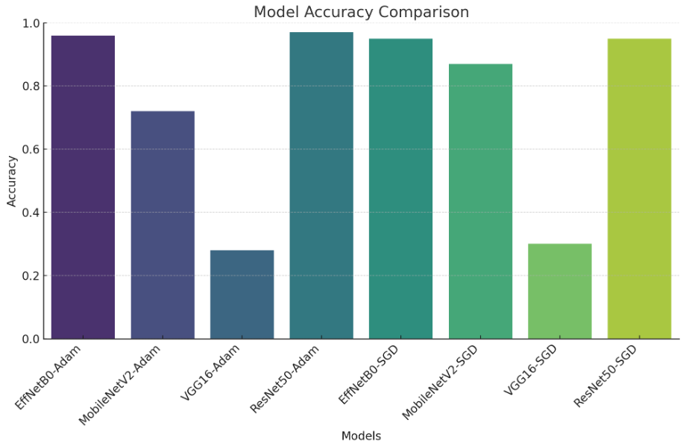
Result
Best Model: EfficientNetB0 with Adam.
Why EfficientNetB0?
Higher accuracy than MobileNetV2, VGG16, and ResNet50.
More efficient with fewer parameters than ResNet50 and VGG16.
Better feature extraction with compound scaling.
Key Takeaway: EfficientNetB0-Adam is the best choice for brain tumor detection, ensuring high accuracy with efficiency.

Slide 13
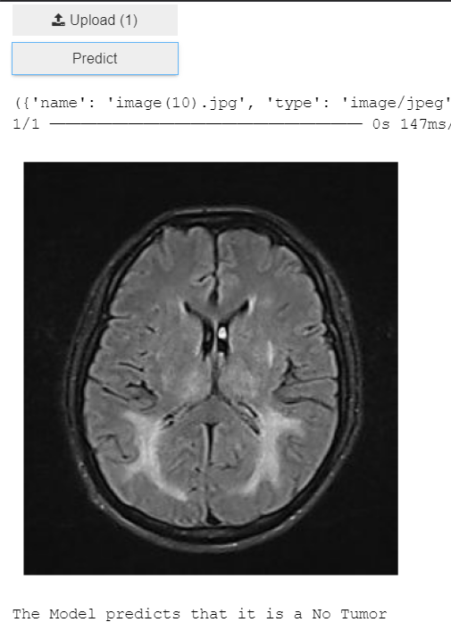
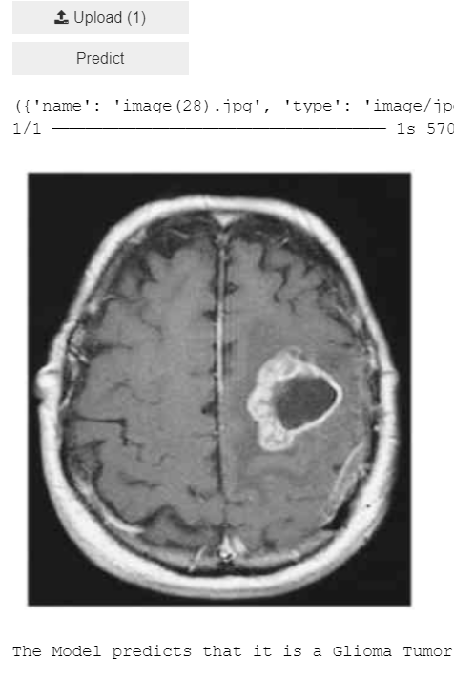
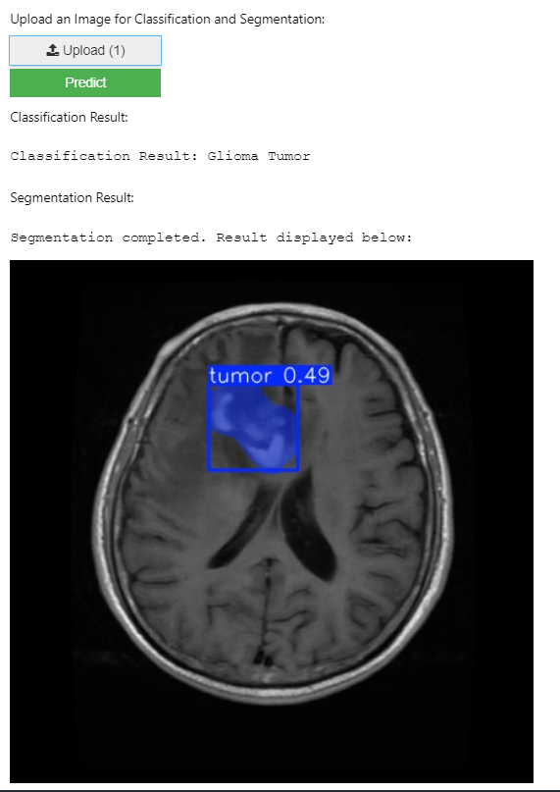
Result
No Tumor Classification Segmentation

Slide 14
Discussion And Future Scope
Diagnosis & Surgery Automates tumor detection and aids in surgical planning with precise segmentation.
Remote Access Enables diagnosis via cloud platforms and telemedicine in underserved areas.
Mobile Health Integrates into smartphone apps for quick, accessible tumor screening.
Emergency Use Real-time analysis supports fast decisions in critical care settings.
Monitoring & Research Tracks treatment progress and supports medical AI research.
Explainability & Expansion Adds interpretability for clinical trust and combines data from CT, PET, and genetics for better accuracy.

Slide 15
Conclusion
The proposed system successfully combines EfficientNet-B0 for classification and YOLOv8 for segmentation of brain tumors.
It achieves high classification accuracy (99.7%) and strong segmentation performance (81.2% mAP).
Transfer Learning significantly reduces training time and enhances performance on small datasets.
The framework delivers real-time results, aiding radiologists in faster and more accurate diagnoses.
The system supports automated medical diagnostics, reducing radiologist workload and minimizing human error.
This research highlights the potential of AI-driven healthcare solutions to improve early detection and patient outcomes.

Slide 16
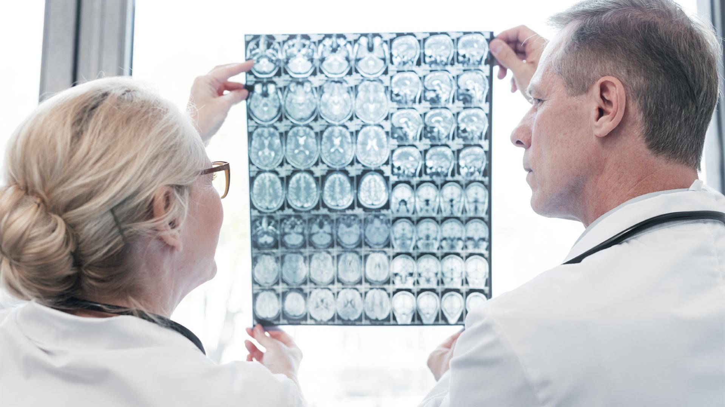
THANK YOU…..

